Slide 1
IB Parent Night #2 The 6 themes & the inquiry cycle
February 15, 2018

Slide 2
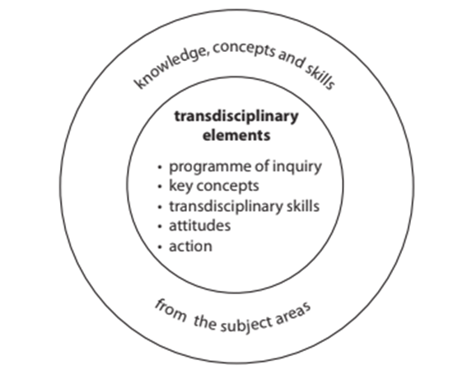
What is transdisciplinary in the PYP?
Transdisciplinary in the context of the PYP programme means to convey learning that has relevance across the subject areas and more importantly, learning that transcends the confines of the subject areas to connect to what is real in the world.
Surrounds the 5 essential elements : Themes, key concepts, trandisciplinary skills, attitudes and action, along with the Learner Profile.
IB hopes the PYP exemplifies: the need for coherence in curriculum, schools being a learning community, collaborative and discovery approach to issue and inquiry based learning, and being active and participatory in promoting critical thinking.

Slide 3
What is the IB goal of the transdisciplinary themes?
The challenge for the PYP, since its inception, has been to define the knowledge component—what is worth knowing that is of relevance to 3–12 year olds, wherever they are in the world and regardless of which ethnic or cultural group they belong to.
The resolution of this dilemma in the PYP is the defining of six globally significant transdisciplinary themes that resonate with, and allow us to explore, our human commonality.
They are significant because:
They contribute to the uniqueness of the PYP
They ensure and extend the international dimension of the programme
They require learning about what is “real” in the world
The indicate the complexity and the connectedness of the human condition.

Slide 4
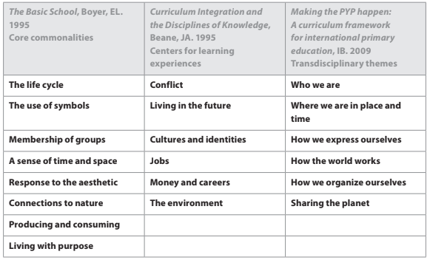
The transdisciplinary themes:
The IB aims for these themes to not be derived from the traditional subject areas but, in their scope, they transcend them.
This is the change in the thinking of the IB to more holistic approach:

Slide 6
Why inquiry based learning?
IBL is a process where students are involved in their learning, formulate questions, investigate widely and then build new understandings, meanings, and knowledge.
The knowledge is new to the students and may be used to answer a question, to develop a solution, or to support a position or point of view.
The knowledge is usually presented to others and may result in some sort of action.
According to research, IBL will help students become more creative, positive, and independent.

Slide 7
Characteristics of classrooms using IBL successfully:
Inquiry is in the form of real-life problems within the context of the curriculum/community.
Inquiry capitalizes on student curiosity.
Data and information are actively used, interpreted, refined, digested, and discussed.
Community and society are connected with the inquiry.

Slide 8
What does inquiry look like?
This can mean:
exploring, wondering and questioning
experimenting and playing with possibilities
making connections between previous learning and current learning
making predictions and acting purposefully to see what happens
collecting data and reporting findings
clarifying existing ideas and reappraising perceptions of events
deepening understanding through the application of a concept
making and testing theories
researching and seeking information
taking and defending a position
solving problems in a variety of ways
Inquiry, interpreted in the broadest sense, is the process initiated by the students or the teacher that moves the students from their current level of understanding to a new and deeper level of understanding.

Slide 9
Ibl is about making connections
Some ways students can make connections by:
Bringing in objects/artifacts
Describing experiences
Reading literature that encourages their own stories
Creating works of art that reflect thoughts
Role playing situations
Writing or sketching responses
Conducting surveys

Slide 10
What is the difference?

Slide 11
The learning-teaching continuum:

Slide 12
Inquiry model:

Slide 13
some samples of inquiry model in a classroom:

Slide 16
Thank you!
If you have any questions, please visit our weebly: www.fa-ib.weebly.com
OR contact : Packard.Ashley@Franklin-Academy.org
Information regarding the next IB Parent Night date will be posted on the Weebly.

